Slide 1

Chapter 2.4 Bayesian Personalized Ranking

Slide 2
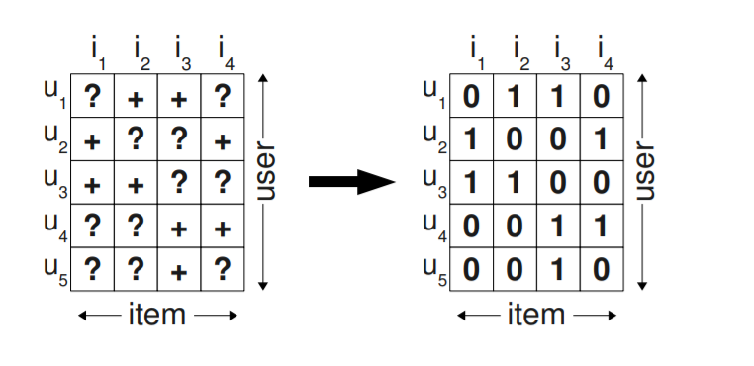
Bayesian Personalized Ranking
One-class collaborative filtering (OCCF)
no negative feedback
Inherently noisy
Preference vs confidence

Slide 3
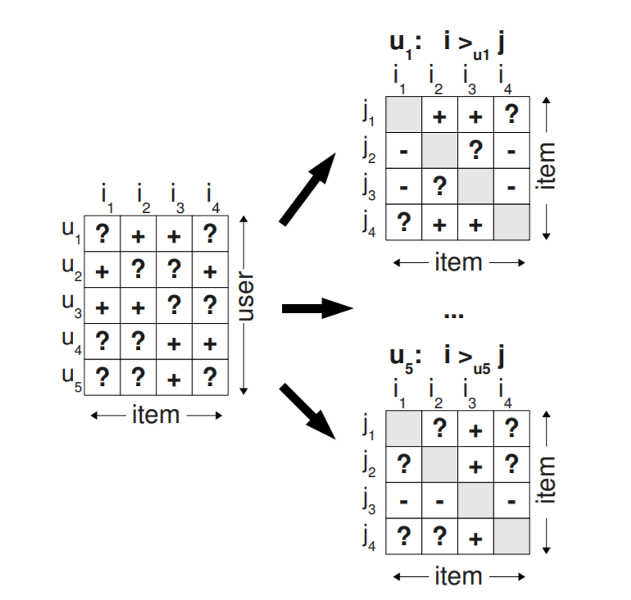
BPR (2)
Assumption
A user prefers an interacted item to an unknown item.
Notes:
Instead of optimizing to predict if an item is selected by a user or not, Bayesian Personalized Ranking optimization (BPR) criterion involves pairs of items (the user-specific order of two items) to come up with more personalized rankings for each user.

Slide 4


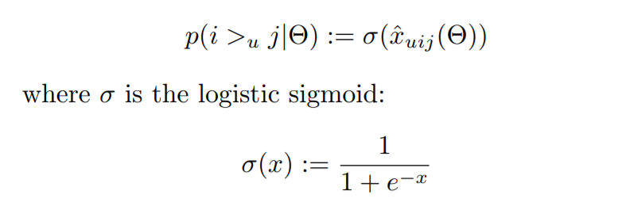

BPR (3)
Assumption
A user prefers an interacted item to an unknown item.
Objective function:

Slide 5
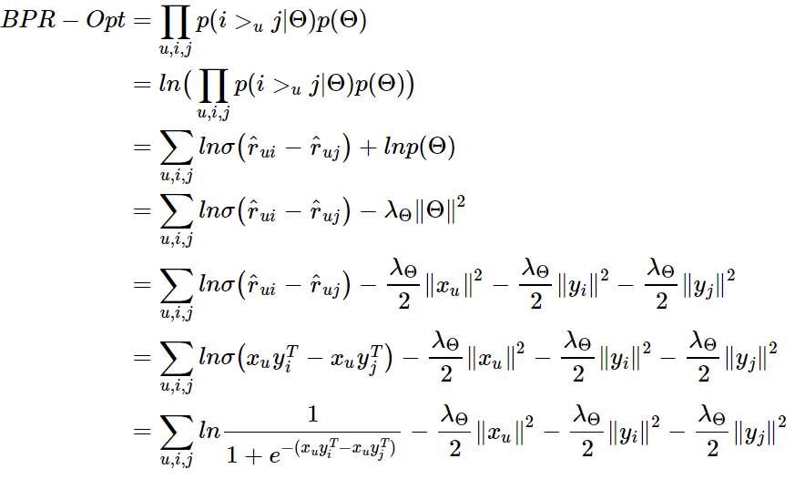
BPR (4)

Slide 6
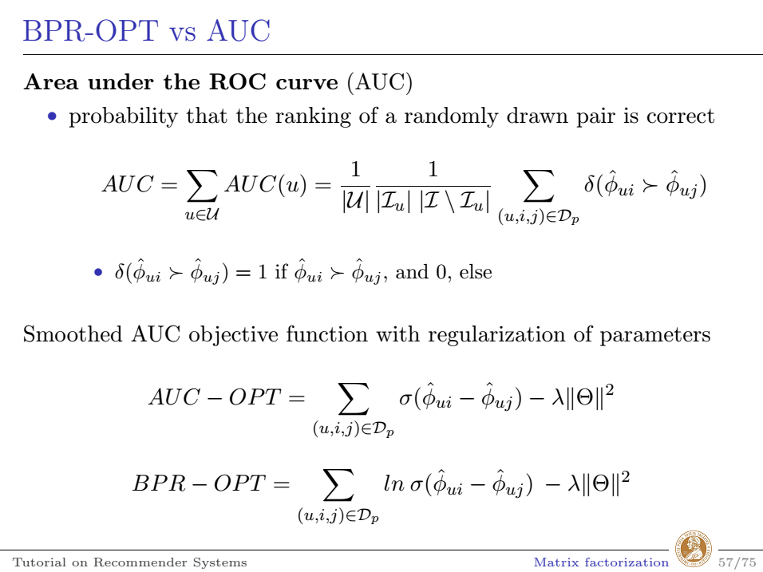

Slide 7
WARP: Weighted Approximate Rank Pairwise
Like the Bayesian Personalized Ranking (BPR) model, WARP deals with (user, positive item, negative item) triplets.
Unlike BPR, the negative items in the triplet are not chosen by random sampling: they are chosen from among those negative items which would violate the desired item ranking given the state of the model.
This approximates a form of active learning where the model selects those triplets that it cannot currently rank correctly.
Notes:
https://ethen8181.github.io/machine-learning/recsys/5_warp.html

Slide 8
WARP (2)
This procedure yields roughly the following algorithm:
For a given user, positive item pair, sample a negative item at random from all the remaining items. Compute predictions for both items; if the negative item's prediction exceeds that of the positive item plus a margin, perform a gradient update so we can rank the positive item higher and the negative item lower. If there is no rank violation, continue sampling negative items until a violation is found.
If we found a violating negative example at the first try, make a large gradient update: this indicates that a lot of negative items are ranked higher than positives items in current state of the model, and the model should be updated by a large amount. If it took a lot of sampling to find a violating example, perform a small update since the model is likely close to the optimum and should be updated at a low rate.

Slide 9
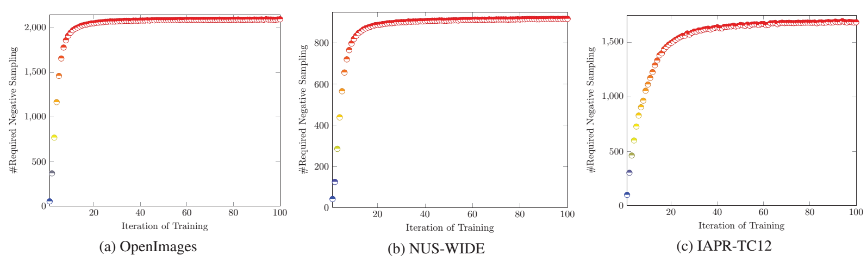
Fast Negative Sampling
Efficiency issue of the WARP sampler
The computational cost of WARP sampling is expensive, in particular when it has been trained after several iterations.
G. Guo, S. Zhai, F. Yuan, Y. Liu, X. Wang, VSE-ens: Visual-Semantic Embeddings with Efficient Negative Sampling, AAAI 2018

Slide 10
Fast Negative Sampling (2)
Our sampling strategy
to choose the negative examples that are most likely to meet the requirements of violation
G. Guo, S. Zhai, F. Yuan, Y. Liu, X. Wang, VSE-ens: Visual-Semantic Embeddings with Efficient Negative Sampling, AAAI 2018

Slide 11
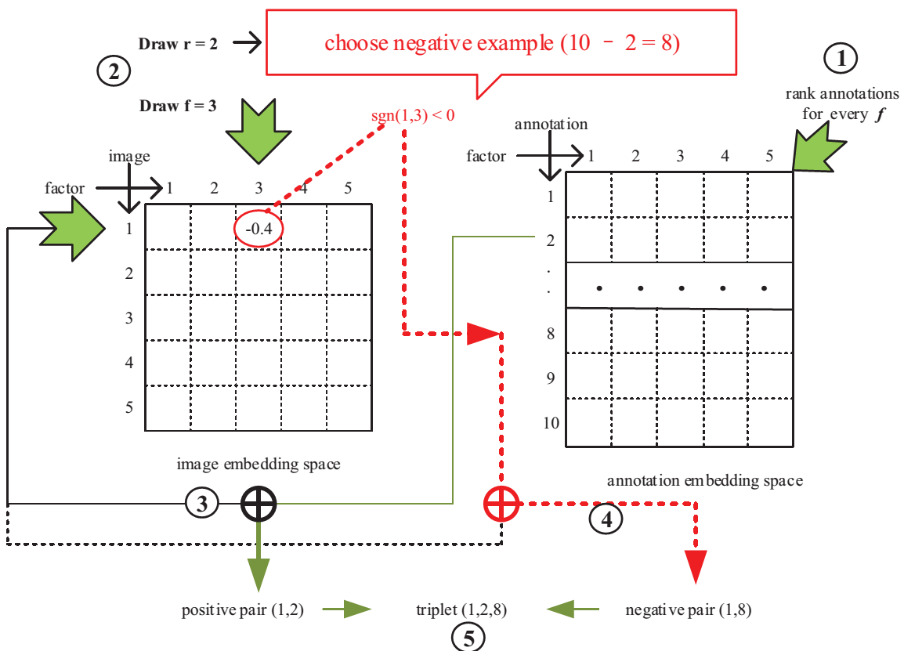
Fast Negative Sampling (3)
Notes:
Following Algorithm 1, our model will rank these annotations according to va,f for each dimension f, and compute the value of σ_f and μ_f at the first iteration. Then, it will randomly choose a positive image-annotation pair, e.g. the 1st image and the 2nd annotation, denoted as (1,2). After this, the negative sampler will sample a rank r, e.g. r =2 according to the designed distribution and a dimension f, e.g. f =3. Finally, we are able to return the negative example according to sgn(v1,3), i.e., choosing the negative annotation from the ranked list with r=8, f=3 if sgn(v1,3)<0, and r=2, f=3 if sgn(v1,3)>0.

Slide 12
Training without Sampling
fBGD: fast batch gradient descent
First, we showed how to efficiently train a class of embedding models by batch gradient descent for positive unlabeled (PU) data.
Second, we identified an unstable gradient issue in fBGD due to the large batched summation of sparse features, and solve it by an intuitive way.
F. Yuan,X. Xin, X. He, G. Guo, W.Zhang, T. Chua, J. Jose, fBGD: Learning Embeddings from Positive-Only Data Without Sampling, UAI 2018

Slide 13
Multi-dimensional Feedback

Slide 14
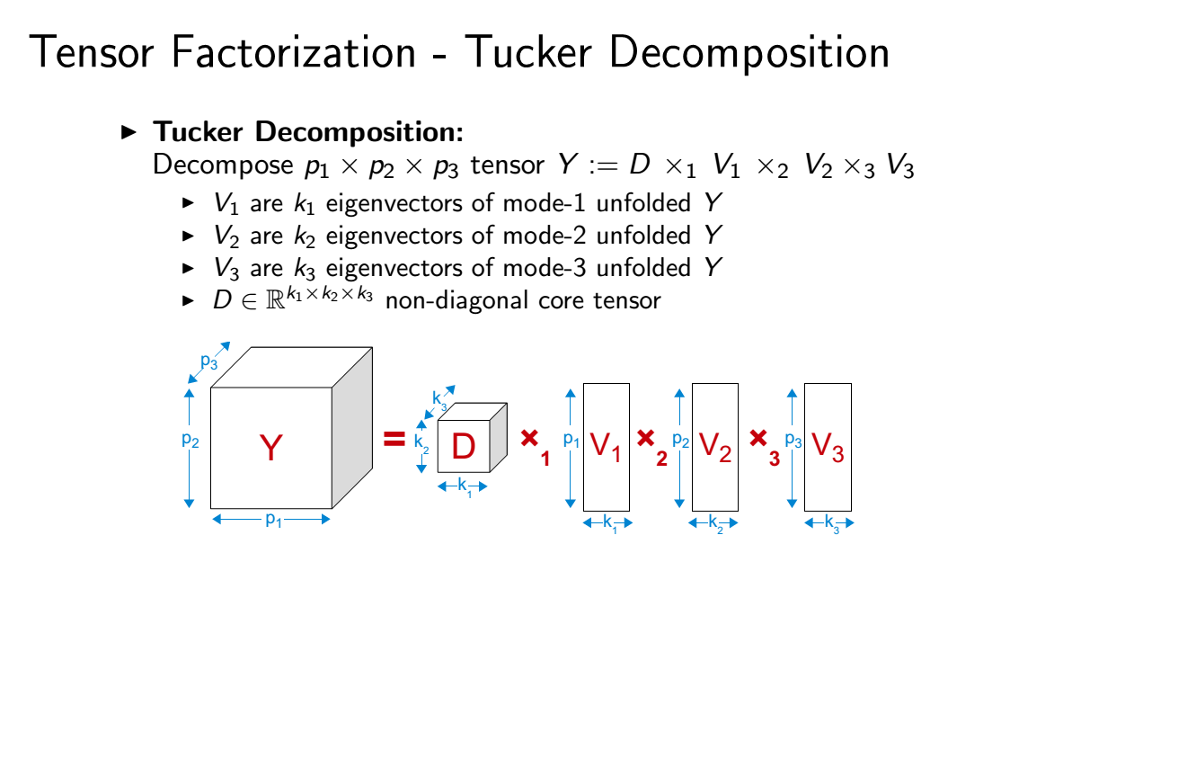
Tensor Factorization

Slide 15
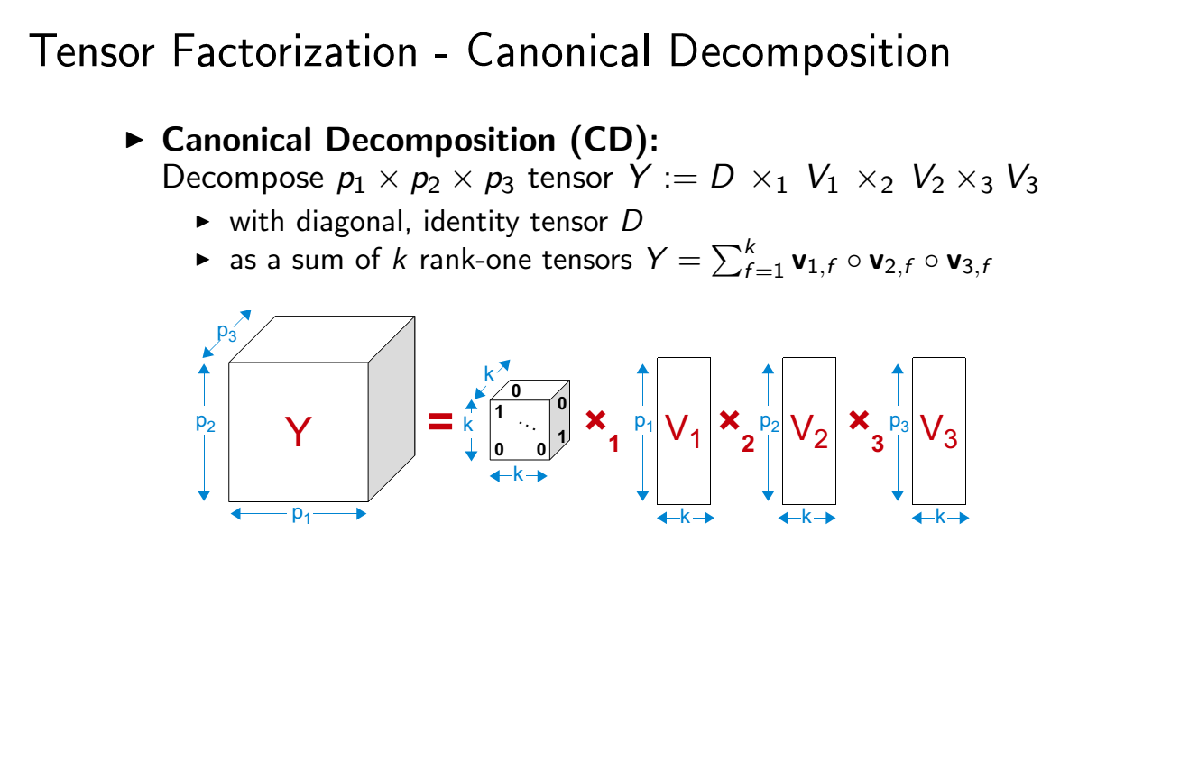
Tensor Factorization (2)

Slide 16
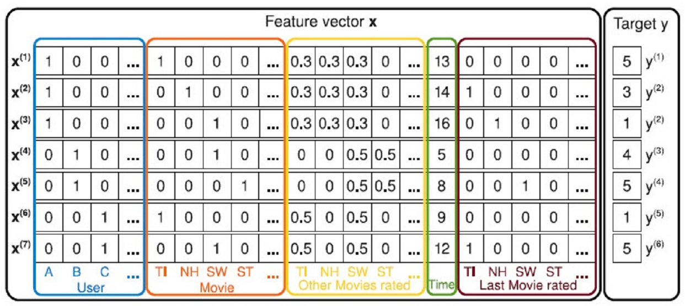
Factorization Machine
Notes:
https://ethen8181.github.io/machine-learning/recsys/factorization_machine/factorization_machine.html

Slide 17
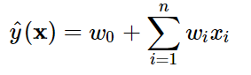

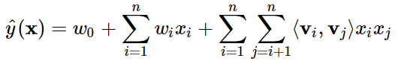

Factorization Machine (2)
Notes:
https://ethen8181.github.io/machine-learning/recsys/factorization_machine/factorization_machine.html
For the second term: But we have now ended up with a O(n^2) complexity which means that to train the model, we now require a lot more time and memory. Another issue is that when we have categorical variables with high cardinality, after one-hot encoding them, we would end up with a lot of columns that are sparse, making it harder to actually capture their interactions (not enough data).

Slide 18
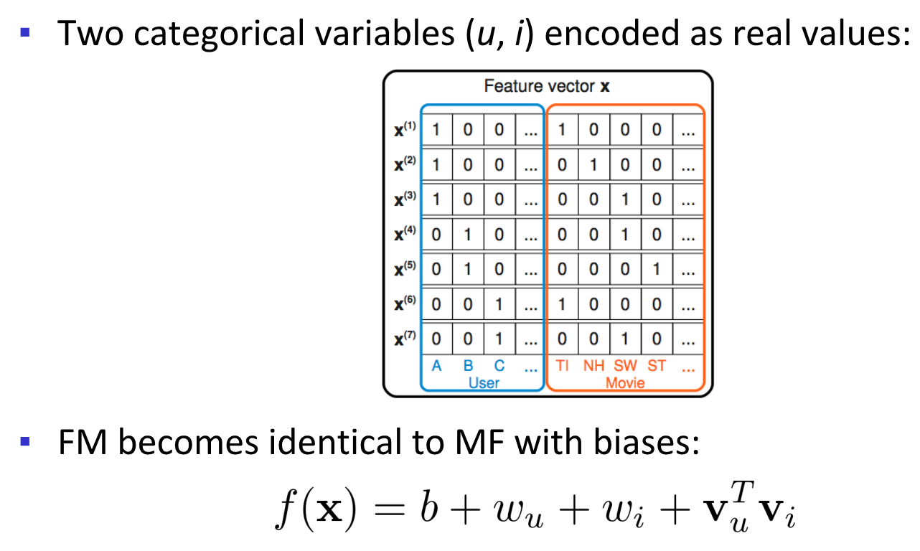
Factorization Machine (3)

Slide 19
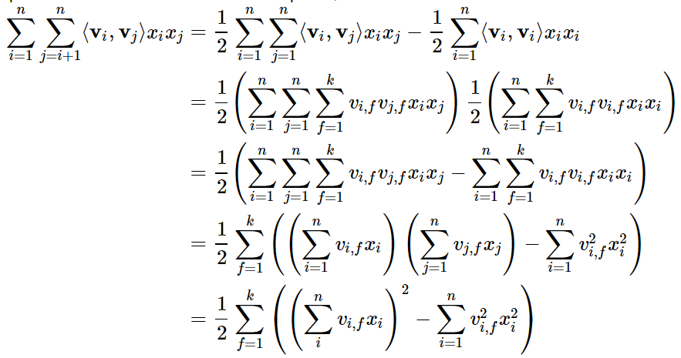

Factorization Machine (4)
Simplification from $O(kn^{2})$ to $O(kn)$

Slide 20
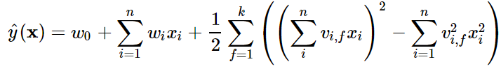
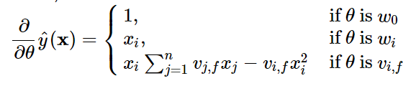
Factorization Machine (5)
The final formulation is:
The gradients can be computed by:

Slide 21

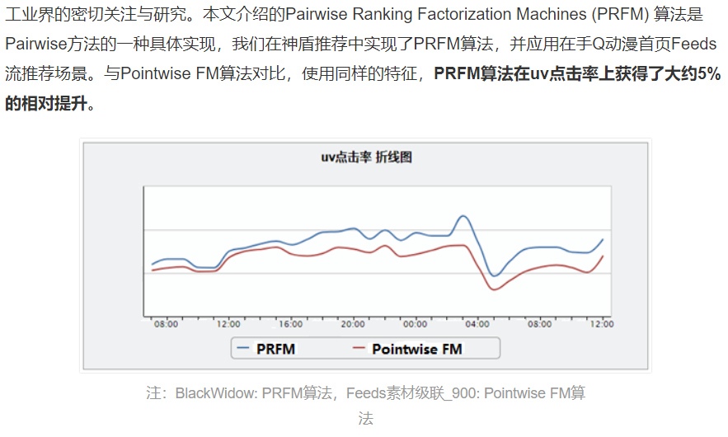

LambdaFM
F. Yuan, G. Guo, J. Jose, W. Zhang, L. Chen, H. Yu. LambdaFM: Learning Optimal Ranking with Factorization Machines Using Lambda Surrogates. CIKM 2016. (CCF-B)
21
https://cloud.tencent.com/developer/article/1063837?from=timeline&isappinstalled=0

Slide 22
LambdaRank
Assume implicit objective function C
Goal: compute dC/ds_{i}
s_{i} = f(x_{i}) denotes score of document x_{i}
Given gradient on document scores
Use chain rule to compute gradient on model parameters (of f)
[Burges et al., 2006]
Notes:
References:
C. Burges, R. Ragno, Q. Le. “Learning to Rank with Non-Smooth Cost Functions.” In Proceedings of NIPS 2006

Slide 23
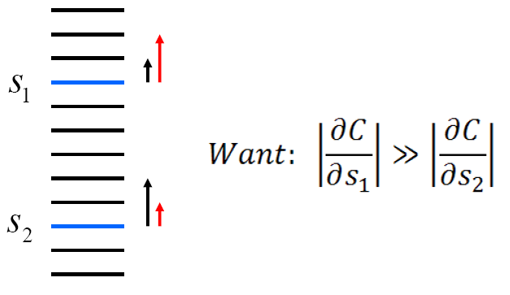
[Burges, 2007]
Intuition:
Rank-based measures emphasize top of ranking
Higher ranked docs should have larger derivatives
(Red Arrows)
Optimizing pairwise preferences emphasize bottom
of ranking (Black Arrows)
Notes:
References:
C. Burges. “Learning to Rank for Web Search: Some New Directions.” Keynote Speech, SIGIR 2007 Workshop on Learning to Rank for Information Retrieval.

Slide 24
LambdaRank for NDCG
The pairwise derivative of pair i,j is
Total derivative of output s_{i} is

Slide 25
Properties of LambdaRank
¹There exists a cost function C if
Amounts to the Hessian of C being symmetric
If Hessian also positive semi-definite, then C is convex.
¹Subject to additional assumptions – see [Burges et al., 2006]
Notes:
References:
C. Burges, R. Ragno, Q. Le. “Learning to Rank with Non-Smooth Cost Functions.” In Proceedings of NIPS 2006

Slide 26
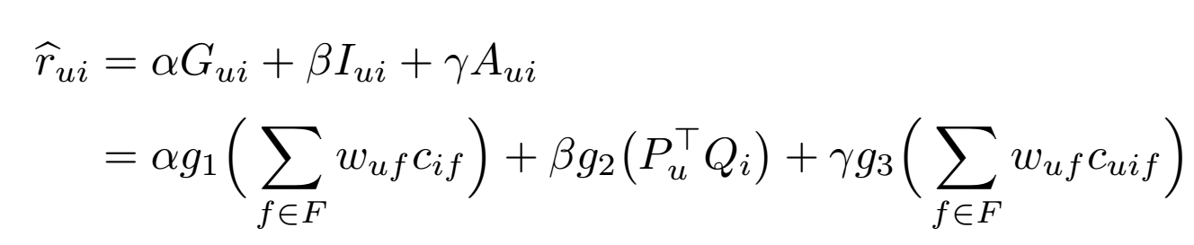
Multi-behavior MF
Multi-facet User Preference Learning (MUPL)
Group-facet
Individual-facet
Action-facet

